Slide 1
Understanding the Business Domain
A module in the
Agile Business Analysis
workshop
This work is licensed under the
Creative Commons Attribution-ShareAlike 4.0 International License.
To view a copy of this license, visit http://creativecommons.org/licenses/by-sa/4.0/.

Slide 2
Topics
Define the analysis approach
Roles and goals
Business process
Personas
Scenarios
Prototypes

Slide 3
BA Artifacts
Inception
Iterations
Vision
Prioritized business objectives
Roles & personas
Scenarios
Narratives
Story maps
Right sized stories
Initial story list (Backlog)
Release plan with estimate
Functional test matrix
Notes:
A number of artifacts are created during inception. Typically only 1 during Iterations.
To help get to an initial estimate, release plan
The analyst is key to understanding what needs to be built functionally
There are a number of techniques used to obtain that understanding.
Are all these documents kept up to date? Not unless you discover a large piece missing. A whole scenario missing from the process flow. A role missing or completely off the mark definition.
The level of detail of the inception artifacts are at a much higher level than traditional methodologies.

Slide 4
Analysis Approach
Identify goals
Define techniques and artifacts
Define participants
Determine participant time commitments
Notes:
This is typically done prior to the start of the inception, but continually modified as necessary. This should really read “update the analysis approach for the inception, plan the analysis approach for development”.
Includes items for Inception and Development.
Inception – what models, who needs to participate, scheduling.
Development - Narrative review process to be followed during development.
Low: 1min
High: 2min

Slide 5
Making the right choice
Agile
Non Agile
Volatile requirements
Stable requirements
Automation
Little Automation
Customer readily available
Customer not accessible
Co-located team
Segregated team
Time to market matters
Fixed scope matters
Notes:
Remember this slide.
Is this an complex environment with volatile requirements.
May have gotten this queue from the “Remember the Future” (futurespective).
Less detail and more analysis risk
What tools will you be required to use? Requirements tracking, artifact management
Where are your customers? Co-located, readily available?
How will you communicate? How often?
Is there a proxy?
Risk with not having the customer in the Inception phase.
Can you get to other team members for reference, clarification?
Time to market means speed and managing scope.
Low: 3min
High: 6min

Slide 6
Models
$
Financial model
Scenario
Step 1
Step 2
Business process model
Step 3
Prioritized list
Title: Priority:
As a ……
Story Card
Prototype (lo/mid fi)
Notes:
Define how you will capture the information that you plan to obtain from various sources.
Will it be lite weight, cards, paper
Will it be more sophisticated, software.
What technique will you use for business process modeling?
Start with index cards and stickies
Visio or another tool
How will you capture stories?
Index cards,
Transferred to excel or another tool at some point
What approach, tools will you use for prototyping?
Is there a UX person and will they need to be scheduled?
A context model (often a data flow diagram) showing how your system fits into its overall environment
A high-level business requirements model (often an essential use case model)
A glossary defining critical business terms
A domain model (often a class diagram or data diagram) depicting major business classes or entities
A business process model (often a data flow diagram or activity diagram) depicting a high-level overview of the business process to be supported by your system. This diagram is one level of detail greater than your context diagram
Low: 4min
High: 10min

Slide 7
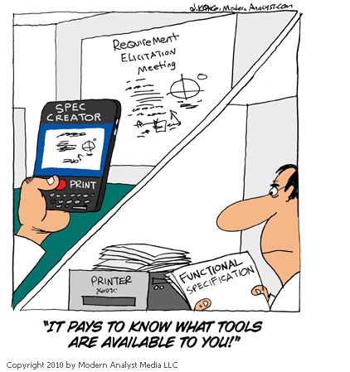
Notes:
Low: 1min
High: 3min

Slide 8
Roles & Goals
Notes:
The techniques discussed here are similar to traditional analysis techniques.
Agile does them quicker and at a higher level.
Agile uses index cards and post its and other fun office supplies to elicit and temporarily capture the data.
Understand just enough to make an estimate.
Understand just enough to get a fully formed picture of the solution, but not every detail.
Low: 1min
High: 3min

Slide 9
Roles and Goals
Who am I?
What do I want to do?
How will you support my goals?
Managing Director
“I’d like to easily see the status of Customers’ invoices”
Provide online information regarding Customers’ accounts.
Administrative Assistant
“ I need to generate a lot more letters than I do today”
Provide an automated approach to letter generation.
Technology Manager
“ I want to easily support all users”
Provide a solution in a language I can support.
Sales
“ I want to be able to sign on more customers with confidence.
Provide a system that can accommodate additional customers with the quality service.
Customer
“ I need to be confident that DC knows the status of each of my debtors’ invoices”
Provide a way to reflect invoice status by Debtor.
Notes:
Understand the differences between users of the same role.
Admin asst.
Sales. Manager, Sales folks.
Is Customer a role we should track?
Low: 3min
High: 6min

Slide 10
Debt Chasers Roles
Who am I?
What do I want to do?
How will you support my goals?
Break into groups of 4-5 people. Select a Role.
Refer to the introduction to DebtChasers
Answer the above questions for your Role
Consider the following questions
Goals & Roadblocks
What are their goals in their job?
What are their personal / career goals?
What are common frustrations in their job?
What are daily roadblocks?
Context of use
What are their 3 most common tasks?
What are their 3 important performance metrics?
Notes:
Using a flip chart and whatever other materials, please provide the following information for your role.
Roles:
Managing Director
Administrative Assistant
Technology Manager
Sales Person
Sales Manager
Customer
Low: 15min
High: 30min

Slide 11

Debrief
What went well?
What key learnings did you take from that exercise?
What still puzzles you?
Notes:
Debrief:
What went well?
What key learning's did you take from that exercise?
What still puzzles you?
Low: 5min
High: 15min

Slide 12
Business Process
Notes:
The techniques discussed here are similar to traditional analysis techniques. Agile does them at a higher level.
Understand just enough to make an estimate.
Understand just enough to get a fully formed picture of the solution, but not every detail.
Low: 1min
High: 3min

Slide 13
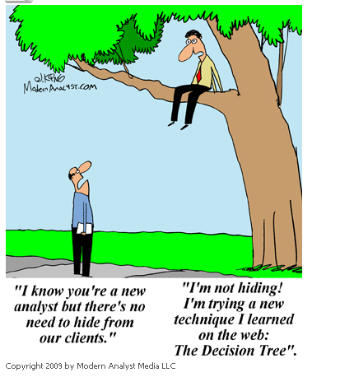
Notes:
[Doc says: like the last one, I’m not sure if you’re going to talk here.]
Low: 1min
High: ??

Slide 14
What Techniques?
There are many techniques that help drive out a Business Process
What techniques have proved useful for you?
Notes:
Low: 3min
High: 10min

Slide 15
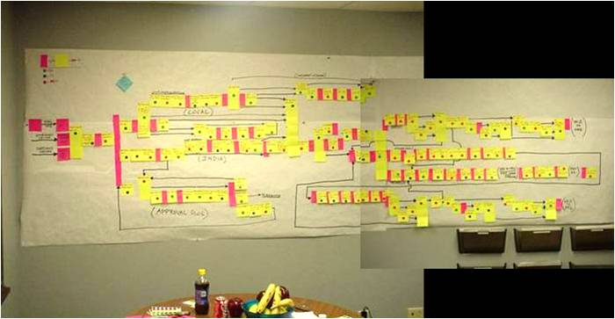
Process modeling
Notes:
Process modeling is not new to analysis. Agile just uses cards and different types of stickers to reflect
Tasks – manual, automated
Roles
Significant details
Pain points
Other techniques – Action mapping, value stream mapping
Observation is a great way to understand really what the users do now. They can tell you what they do, but showing you always brings out the pain points and details they forget to share. Those could be ‘gotchas’ later. In the form of missed requirements.
Low: 2min
High: 4min

Slide 16
BPM for Debt Chasers – As Is World
Notes:
Should/can convert the cards and stickers to an electronic format for distribution, reference.
Traditional swim lanes presentation.
Identify pain points. If they haven’t already told you about them. ☺
Which are the areas causing the most pain?
Where would you stream line the process?
What does your client/customer feel?
How do you reach a consensus?
Low: 3min
High: 6min

Slide 17
Adding Pain Points
Notes:
Pain points highlight opportunities for change.
A ‘to be’ process is generally created to reflect the elimination of the pain points.
Low: 3min
High: 8min

Slide 18
Pain Point Analysis
What questions could you ask to identify process improvements?
Notes:
How can we improve?
How can we make Abigail’s life easier?
What processes can we streamline?
Where can we improve business value?
Ask what value each step brings to the process – are they stuck in this flow because it has it always been done this way?
If you were to change the way you do things, which would be your top 3 issues?
Can you explain to us, the limitations of your process?
If you were to change the way this process is performed, which would be your top 3 issues?
If you were to change the way this system behaves, which would be your top 3 issues?
Low: 5min
High: 15min

Slide 19
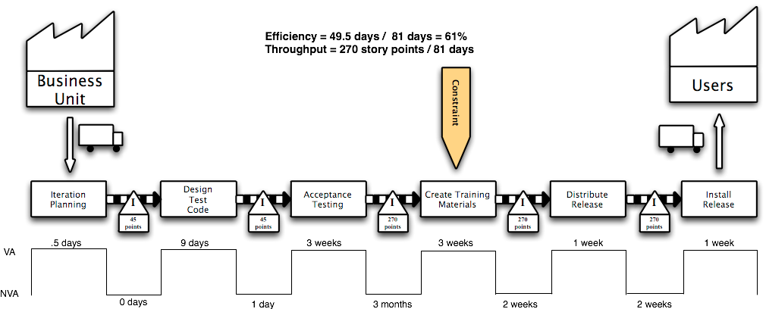
Value Stream Mapping
Notes:
Highlighting waste as well as pain points.
Add waste into your process map?
Cycle times.

Slide 20
Personas
Notes:
Low: 1min
High: 3min

Slide 21
Understanding Users
First, we need to answer some questions:
Who will be using our software? Roles.
Why will they be using our software?
What important characteristics do these people possess?
Notes:
We know what Roles need to use our software,
but do we know the differences in the way different people of same role will use the system?
Low: 2min
High: 5min

Slide 22
Understanding Users
Next, we need to:
Document what we know in personas for each role
Arrive at consensus around our personas
Notes:
We know what Roles need to use our software,
but do we know the differences in the way different people of same role will use the system?
Low: 2min
High: 5min

Slide 23
Understanding Users
Finally, we need to reference our personas as we design the interface.
Notes:
We know what Roles need to use our software,
but do we know the differences in the way different people of same role will use the system?
Low: 2min
High: 5min

Slide 24
What is a Persona?
Archetype / representation / profile
Description of end users
Reference document
Notes:
How many of you have heard of, worked with, created personae before?
You are not a user!
Create personas to bring the users to life
Fictional name, not Customer 1, but Ryan Green
Personas are about behavior patterns – they are not job descriptions
They act as a frame of reference throughout the Inception and development. “How would Ron feel about this?”
Use pictures to help the team see the personas as real people
Original bullets:
An archetype, representation or profile of our end-users
A description of our end-users that includes:
An overview of their role and their goals
Details of key characteristics
A name and a photo that give a human touch
A reference document to focus future discussion and debate
Low: 2min
High: 5min

Slide 25
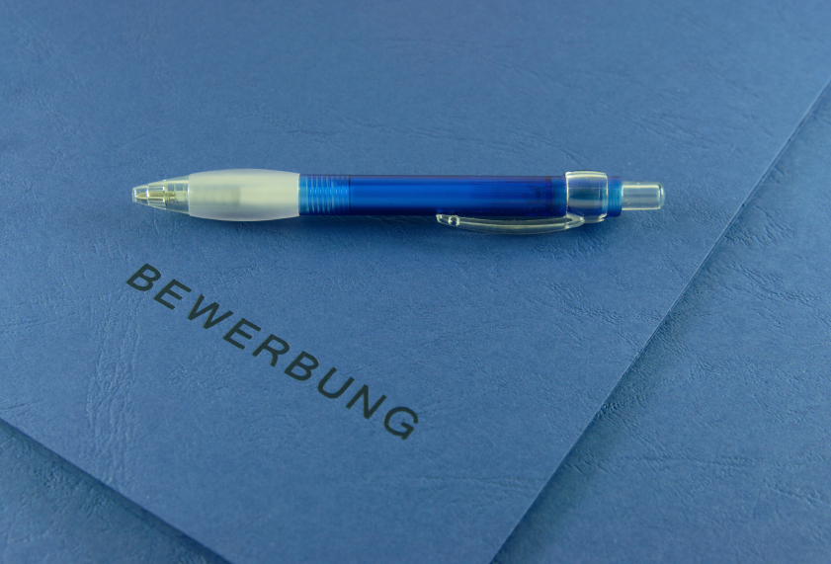
Attributes of a Persona
Biographic
Demographic
Notes:
Biographic
The personal story of their life. Where they grew up, where they went to school, marital status
Demographic
Vital statistics. Age? How long have they worked there? # of people in that role?
Low: 1min
High: 3min

Slide 26
Attributes of a Persona
Psychographic
Technographic
Notes:
Psychographic
How do they feel about the company, their job, this project?
Technographic
How technical are they? What types of programs do they use at work? At home?
Low: 1min
High: 3min

Slide 27

Attributes of a Persona
Relationship to the business
Business relationship to person
Knowledge and experience
Notes:
Relationship to the business
Role, status, perception
Business relationship to person
Brand, attitude
Knowledge and experience
Subject matter, computer proficiency, employment history, Novice, beginner, intermediary, expert
Low: 1min
High: 3min

Slide 28

Attributes of a Persona
Goals, needs, desires, attitudes, motivations
Environment
Context of usage
Notes:
Goals, needs, desires, attitudes, motivations
Emotional, motivational, big picture, needs, frustrations, attitude to jobs
Environment
Physical, technical, space, location, lighting
Context of usage
Task content, role, responsibilities, device constraints, error tolerance
Low: 1min
High: 3min

Slide 29
How to develop personas
Identify roles and goals
Distribute behaviorally
distinct traits
Assign attributes
Personas
Notes:
For the administrative staff, how many different behaviors do you think we have with 20 folks?
Low: 2min
High: 5min

Slide 30
Debt Chasers Personas
Stay in the same groups as the Roles & Goals exercise.
Describe a day in the life
Identify the applicable characteristics.
Create at least 2 different personas for each of your roles
Be prepared to discuss how the personas will help design the solution
Notes:
Requires a handout of the attributes of a persona.
Post it flip chart paper
Some pictures to attach to the personae.

Slide 31
Debrief
What went well?
What key learnings did you take from that exercise?
What still puzzles you?
Notes:
Debrief:
What went well?
What key learning's did you take from that exercise?
What still puzzles you?
Low: 5min
High: 15min

Slide 32
Scenarios
Notes:
Low: 1min
High: 3min

Slide 33
User Scenarios
Inform thinking
End-to-end journey
Formula: scenario = persona + task + environment
Notes:
User / business scenarios help with ….
Real business deliverable
Interdependent processes
Domain dependencies
User experience variances
Interface opportunities/requirements
Onboarding
UAT
QA
Original slide content:
Use scenarios to inform your thinking and create an end-to-end journey
Consider a persona + a task + an environment
Use scenarios to drive out requirements and to validate that solutions can solve the tasks identified in all possible environments.
Low: 3min
High: 6min

Slide 34
User Scenarios
Use scenarios to drive out requirements and to validate that solutions can solve the tasks identified in all possible environments.
Notes:
User / business scenarios help with ….
Real business deliverable
Interdependent processes
Domain dependencies
User experience variances
Interface opportunities/requirements
Onboarding
UAT
QA
Low: 3min
High: 6min

Slide 35

User Scenarios
“I have 165 invoices to process today, I’d really like to get it done quickly so that I know that I’ll have time to deal with any customer & debtor requests, so that I can deal with them more effectively in a less stressed way.
For each new invoice I need to record the customer details, the debtor details and then I need to type and send the first letter to the debtor.”
Notes:
User / business scenarios help with ….
Real business deliverable
Interdependent processes
Domain dependencies
User experience variances
Interface opportunities/requirements
Onboarding
UAT
QA
Low: 3min
High: 6min

Slide 36
Scenarios
Business Scenario – “Modify an invoice status”
Individual Stories
Search for invoice by customer
Select invoice from results
Update invoice status
Close invoice
Save Invoice
Test 1
Test 2
Test 3
Test 1
Test 2
Test 1
Test 2
Test 3
Test 1
Test 2
Test 3
Test 4
Test 1
Test 2
Test Scenarios
Notes:
Business scenarios represent a combination of stories to represent a complete functional process.
Completed during inception and during development if needed to support new functionality/features/requirements.
Test scenarios are detailed steps to complete a test for a story card. Developed during development/iterations.
Low: 2min
High: 5min

Slide 37
Debt Chasers Scenarios
Stay in the same groups as the Personas exercise.
Pick a scenario that your role will likely go through
Define the steps for that scenario
Write the steps on index cards
Use color if appropriate

Slide 38
Prototypes
Notes:
Low: 1min
High: 3min

Slide 39
Prototypes
Models
Represent screens and flow
Lo-fi, Mid-fi
Low cost, easy to change
Helps test usability
Components become stories
Notes:
Also referred to as wireframes.
Once you have process flows defined, you can begin to draw screens to accommodate those flows.
Try running the scenarios through the screens.
Lo fi – paper, post its
Mid fi – Balsamiq, Visio or other tool. Incorporates color schemes, allows for distributed sharing, etc
Neither should look finished, therefore setting the correct expectation that these are ideas, not the final design.
Fields, buttons, tabs, lists, check boxes, etc – all can be translated to stories.
Low: 1min
High: 3min

Slide 40
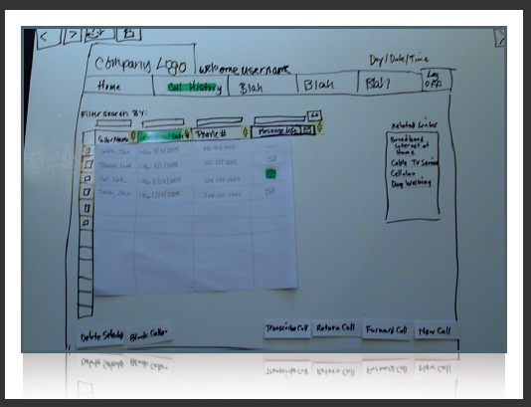
Lo Fi
http://zakiwarfel.com/archives/category/paper-prototyping/
Notes:
The sort of questions you might want to ask based on the prototype are:
- What will the user want to do next?
- What mistakes could the user make here?
- What could confuse the user here?
- What additional information could the user need?
Low: 1min
High: 2min

Slide 41
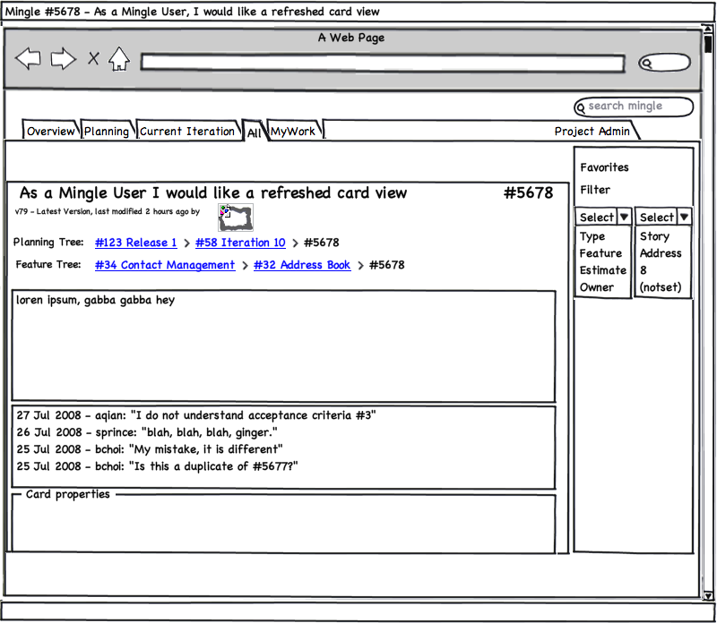
Mid Fi
Notes:
Low: 1min
High: 3min

Slide 42
Hi Fi
Notes:
Main point—don’t do this! If you’re doing a remote inception, and you need to use a drawing tool, then save in “pencil mode” to emphasize that this is a sketch.
Low: 1min
High: 3min

Slide 43
Debt Chasers Prototyping
Stay in the same groups as the Scenarios exercise
Using the scenario you created in the last exercise
Draw one of the pages that will support the scenario

Slide 44
Debrief
What went well?
What key learnings did you take from that exercise?
What still puzzles you?
Notes:
Debrief:
What went well?
What key learning's did you take from that exercise?
What still puzzles you?
Low: 5min
High: 15min

Slide 45
Review
Define the analysis approach
Roles and goals
Business process
Personas
Scenarios
Prototypes

Slide 46
BA Artifacts
Inception
Iterations
Vision
Prioritized business objectives
Roles & personas
Scenarios
Narratives
Story maps
Right sized stories
Initial story list (Backlog)
Release plan with estimate
Functional test matrix
Notes:
A number of artifacts are created during inception. Typically only 1 during Iterations.
To help get to an initial estimate, release plan
The analyst is key to understanding what needs to be built functionally
There are a number of techniques used to obtain that understanding.
Are all these documents kept up to date? Not unless you discover a large piece missing. A whole scenario missing from the process flow. A role missing or completely off the mark definition.
The level of detail of the inception artifacts are at a much higher level than traditional methodologies.

Slide 47
Questions?

